Slide 1
Twitter vs Public
By Francis Stipek

Slide 2
Question
Are posts on Twitter more negative than people’s actual opinions?

Slide 3
Two questions must be answered to perform the comparison:
How will sentiment data on both public opinion and Twitter be acquired?
For which entities will sentiment be compared?

Slide 4
Data on Public Opinion
Market research firm YouGov conducts surveys on brand sentiment and publishes the results.
U.K. population was subject of survey.
Most recent data as of writing is for Q2 2022.
Results show what percent of people have heard of the brand, and opinion towards it, either positive, negative, or neutral.

Slide 5
Twitter Data
Survey data compared against tweets replying to most famous brands, as according to survey.
For validity of comparing UK survey data to Twitter data
Only tweets responding to UK brand accounts were included, i.e., adidasUK
Only tweets sent in Q2 2022 were collected

Slide 6
Twitter Data
Sentiment analysis was performed on the 8000+ tweets spanning 102 companies. The data was aggregated and compared against the survey data.

Slide 7
Findings

Slide 8
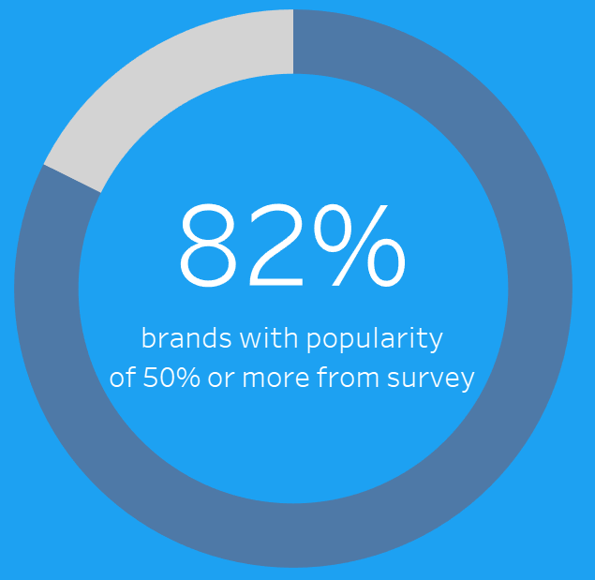
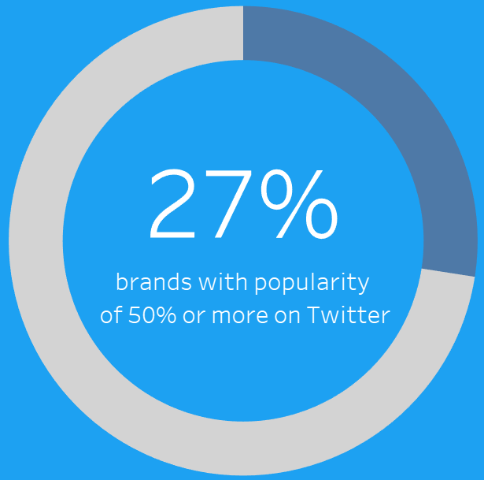

Slide 9
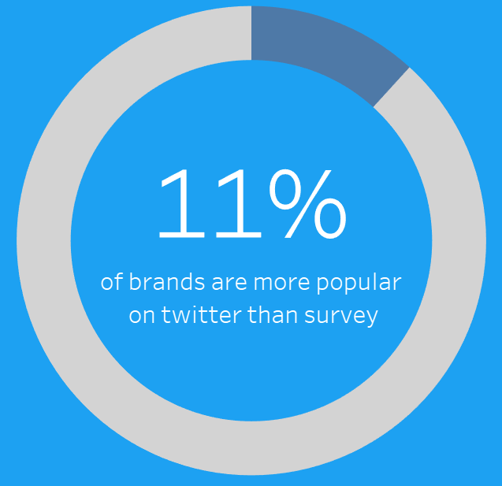

Slide 10

Median Distribution

Slide 11
Considerations
People who had negative experiences with a brand may tweet about it more than those with positive experiences.

Slide 12
Considerations
The sentiment analysis model cannot predict if the tweet had a neutral sentiment. Any such tweet was labeled as ‘positive’ or ‘negative’.
When running the sentiment analysis model on three-star Amazon reviews, 74% were classified as negative.
Subjectively, three-star reviews tend to skew negative, but are the closest approximations of labeled text with neutral sentiment found.

Slide 13
Considerations
Tweets included in analysis were only English based text. Emojis and other languages were excluded.

Slide 14
Future Work
This analysis focuses exclusively on posts responding to major brands.
Analyzing several other categories of tweets would be necessary to come to a complete conclusion about the platform’s negativity.

Slide 15
Dashboard
https://public.tableau.com/views/TwittervsPublic/Dashboard1?:language=en-US&:display_count=n&:origin=viz_share_link

